Slide 1
Smart Phone Usage & Lifestyle Analytics Dashboard
Presentation By: Ria Sangwan

Slide 2
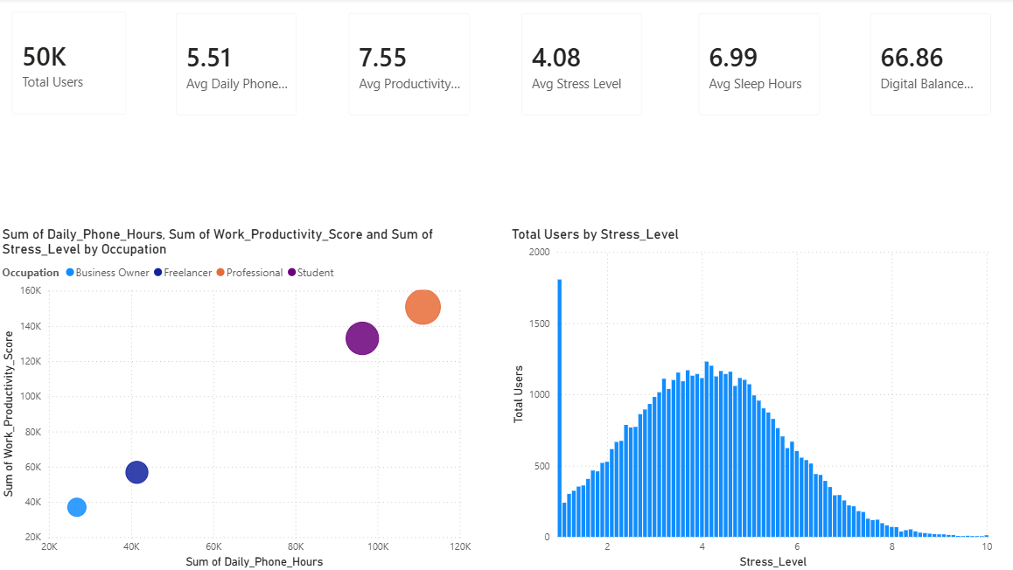
Executive Overview

Slide 3
Explanation Of Executive Overview
The Dashboard summarizes 50k users digital behavior, showing averages for phone usage, productivity, stress, sleep and digital balance.
Users spend about 5.5 hours daily on phones, while maintaining a relatively high average productivity score of 7.55.
Average sleep duration is- 7 hours, suggesting moderate lifestyle balance despite digital engagement.
The bubble chart shows that higher phone usage generally aligns with higher total productivity across occupations, especially professionals and students.
The stress distribution chart indicates that most users experience moderate stress levels(around 3-5), with fewer users at extreme stress levels.

Slide 4
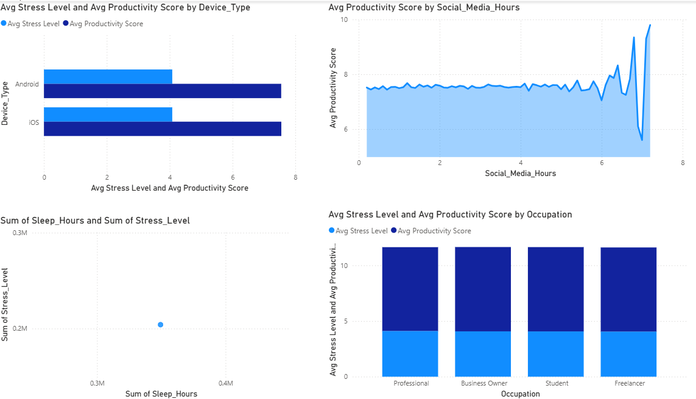
Behavioral Insights

Slide 5
Explanation of Behavioral Overview
Ios and Android users show similar stress levels, but iOS users have slightly higher average productivity score.
Productivity remains stable across moderate social media usage, with noticeable fluctuations at very high usage hours.
The sleep vs. stress chart suggests a relationship where all overall sleep duration impacts accumulated stress levels across users.
Across occupations, productivity scores are consistently high while stress remain moderate for all job groups.
Overall, the dashboard indicates a balanced trend between device usage, social media time, stress and productivity outcomes.

Slide 6
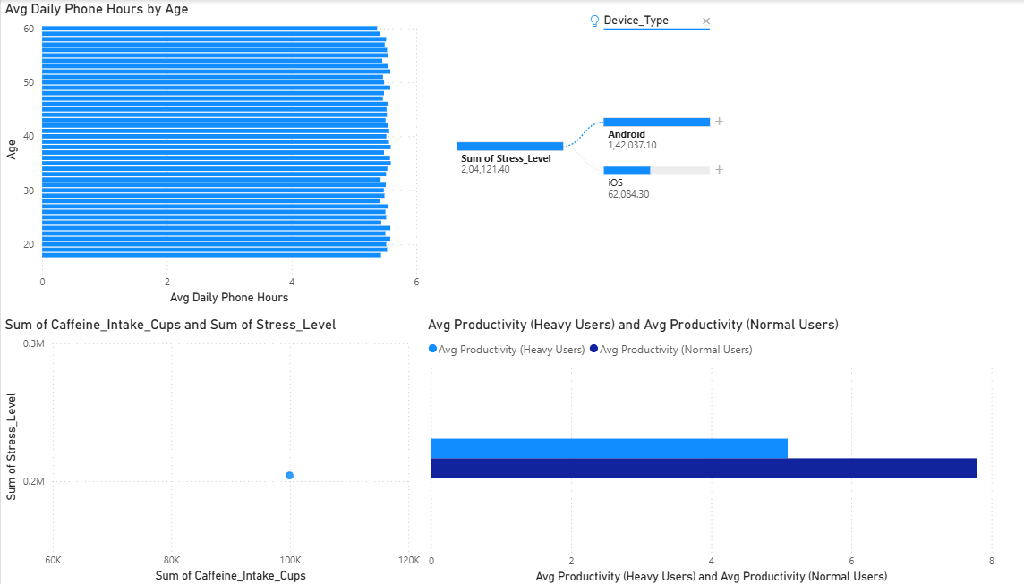
Stress & Productivity Drivers

Slide 7
Explanation of Stress & Productivity Drivers
Average daily phone usage remains fairly consistent across all age groups, staying close to 5-6 hours per day.
The device breakdown shows Android users contributing significantly higher total stress levels compared to iOS users.
Increased caffeine intake is associated with higher accumulated stress levels, indicating a possible lifestyle impact.
Normal users demonstrate higher average productivity than heavy phone users, suggesting excessive usage may reduce efficiency.
Overall, the dashboard highlights how age, device type, caffeine consumption, and phone usage intensity influence stress and productivity trends.

Slide 8
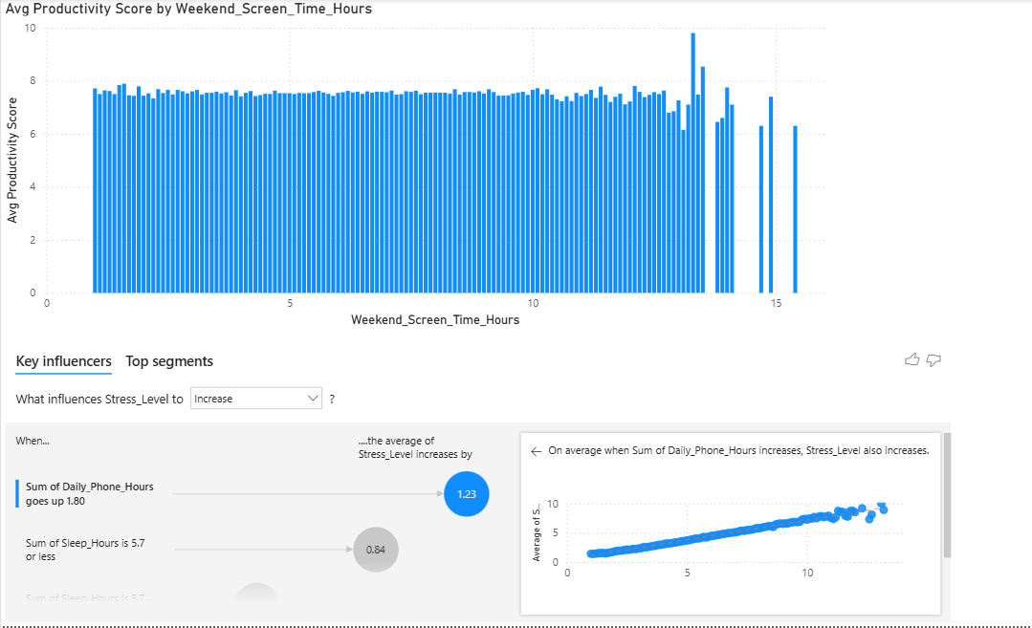
Risk Segmentation

Slide 9
Explanation of Risk Segmentation
Average productivity remains stable around 7–8 scores across most weekend screen time hours, with slight variation at extreme usage levels.
Very high weekend screen time (above ~13–15 hours) shows greater fluctuations and occasional drops in productivity.
Key influencer analysis reveals that increased daily phone hours directly contribute to higher stress levels.
Lower sleep duration (≈5.7 hours or less) is identified as a major factor driving stress level increases.
Overall, the dashboard highlights that balanced screen time and adequate sleep help maintain productivity while reducing stress.

